Slide 1
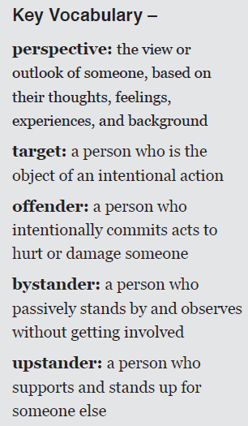
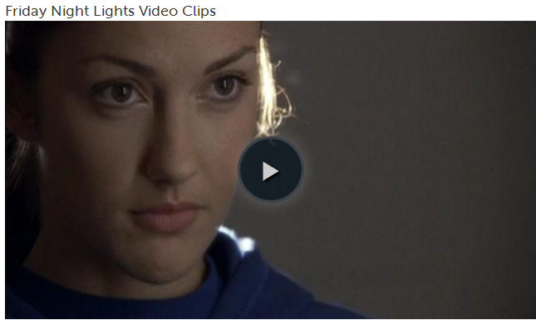
1. Question
Online Cruelty & Cyberbullying
Next
1
2
3
4
5
6
You’ve probably heard the old adage “sticks and stones may break my bones, but words can never hurt me.” Do you believe this is true? Watch the clips from the TV show Friday Night Lights, showing the characters’ different perspectives and reactions to online cruelty or cyberbullying. The clips feature a character named Lyla, who says she would let people say whatever they wanted about her and just “tough it out. “
Do you agree with Lyla’s choice? How did “toughing it out” affect her? What roles did other people around her play? How could they have acted differently?
In this Slam Dunk, you will examine the issues of online cruelty and hate speech to answer the Essential Question:
Images: Common Sense Media
How does online cruelty and cyberbullying affect the people involved, and how can we respond?

Slide 2
2. Information Sources
Next
1
2
3
4
5
6
Review these resources about online cruelty, including cyberbullying and hate speech. Use a digital or non-digital note-taking tool of your choice to gather and summarize main ideas and important details relevant to the Essential Question:
Cyberbullying Statistics
Frequency of Bullying Statistics
What is Cyberbullying?
Phoebe Prince’s Story
The Controversy Over Ask.fm
Combat Hate Speech: There’s an App for That
If You’re a Victim
NY Cyberbullying Law Violate First Amendment
Cyber Bullying Virus
How does online cruelty and cyberbullying affect the people involved, and how can we respond?
Click this link to watch the youtube video:
“Cyber Bullying Virus”

Slide 3
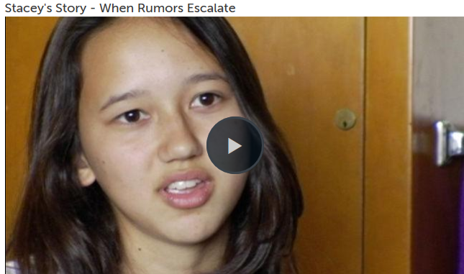
3. Student Activities
Next
1
2
3
4
5
6
Cruelty can escalate quickly online because people are often anonymous and posts spread quickly. To illustrate this, watch the video clip “Stacey’s Story – When Rumors Escalate.”
Complete this activity to analyze this incident and its escalation.
Then use this Graphic Map tool to diagram your findings.
Alye Pollack is a real-life girl who confronted her bullies in a YouTube video titled Words DO Hurt. The clip on the right is a video she posted one year later.
How did Alye’s actions change her situation and empower others?
Image Source: Common Sense Media
* YouTube video accessible to students from home, or at school with teacher login on the Web Filter screen. Image Source: YouTube

Slide 4
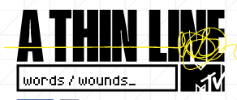
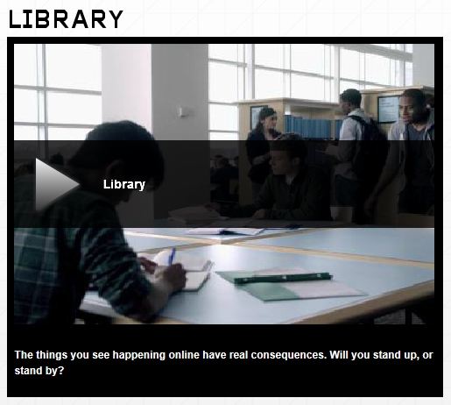
4. Assessment Activities
Next
1
2
3
4
5
6
Use your new knowledge from this brief research to respond to the questions below, as directed by your teacher or librarian.
* Teachers/librarians may create a collaborative online space (such as Edmodo or a Wiki) to facilitate student response and discussion.
How are anonymous actions – like posting on a website or leaving a note – different from things done face-to-face?
Watch the video clip titled Library from MTV’s A Thin Line campaign. At the end of the clip, the young man is faced with a choice. Assume his role. What would you do as a bystander? As an upstander?
How can upstanders help those who face online cruelty? How can they help defuse online cruelty before it escalates?
Do bystanders have a responsibility to do anything when they witness online cruelty? Suppose you were a bystander witnessing an incident of online cruelty unfold today. What would you do?
Image Source: MTV/ www.athinline.com

Slide 5
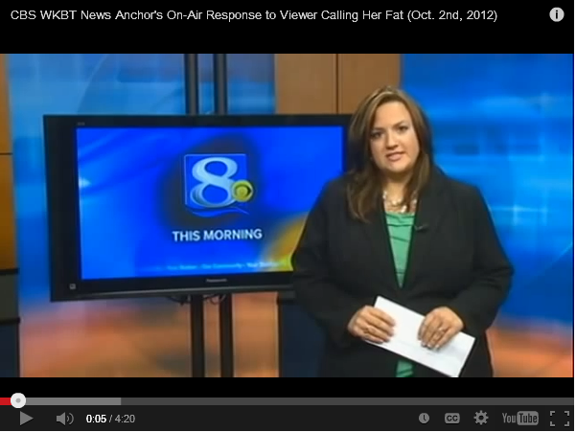
5. Enrichment Activities
Next
1
2
3
4
5
6
Online cruelty is not unique to teenagers: adults have been both targets and offenders. Consider the case of Jennifer Livingston, a Wisconsin news anchor. After being the target of online cruelty, she responded on the air (see the video clip on the left). Her critic, Kenneth Krause, asserts he is correct in criticizing her for health reasons.
With whom do you agree? Why?
Use the Letter Generator to compose a letter to Livingston or Krause explaining your position, or share your view in a face-to-face or online discussion facilitated by your teacher or librarian.
* YouTube video accessible to students from home, or at school with teacher login on the Web Filter screen.
Image Source: YouTube

Slide 6
6. Teacher Support Materials
1
2
3
4
5
6
Digital Citizenship: High School
Maryland Technology Literacy Standards
Standard 2.0 Digital Citizenship: Demonstrate an understanding of the history of technology and its impact on society, and practice ethical, legal, and responsible use of technology to assure safety.
Common Core State Standards Reading: 1. Read closely to determine what the text says explicitly and to make logical inferences from it; cite specific textual evidence when writing or speaking to support conclusions drawn from the text. Writing: 7. Conduct short as well as more sustained research projects based on focused questions, demonstrating understanding of the subject under investigation.
Standards for the 21st Century Learner 1.1.6 Read, view, and listen for information presented in any format (e.g. textual, visual, media, digital) in order to make inferences and gather meaning. 2.1.3 Use strategies to draw conclusions from information and apply knowledge to curricular areas, real-world situations, and further investigations. 3.1.4 Use technology and other information tools to organize and display knowledge and understanding in ways that others can view, use, and assess.
3.1.6 Use information and technology ethically and responsibly.
ISTE Standards for Students
1. Creativity and innovation: Students demonstrate creative thinking, construct knowledge, and develop innovative products and processes using technology. a. Apply existing knowledge to generate new Ideas, products, or processes. b. Create original works as a means of personal or group expression 3. Research and Information Fluency: Students apply digital tools to gather, evaluate, and use information. b. Locate, organize, analyze, evaluate, synthesize, and ethically use information from a variety of sources and media. 4. Critical Thinking, Problem Solving, and Decision Making: Students use critical thinking skills to plan and conduct research, manage projects, solve problems, and make informed decisions using appropriate digital tools and resources. c. Collect and analyze data to identify solutions and/or make informed decisions. 5. Digital Citizenship: Students understand human, cultural, and societal issues related to technology and practice legal and ethical behavior. 5a. Advocate and practice safe, legal, and responsible use of information and technology.
Time Frame: 1-2 class periods
Differentiation strategies for this lesson:
Direct students to use learning tools included in our GCPS-licensed databases, such as: audio read-aloud, labeled reading levels/Lexiles, and embedded dictionaries.
Multiple media formats enable all learners to be engaged.
Students can complete with a partner or small group.
Notes to the teacher:
Collaborate with your school library media specialist to implement this lesson.
Headphones/speakers needed for video components of this lesson.
Consider providing a collaborative online space such as Edmodo, a Wiki, or Voice Thread for students to discuss their responses to the questions posed on Slides 4 & 5.
For supplementary materials and answer see these Common Sense Media Lesson Plans, from which materials in this Slam Dunk have been used or adapted:
Turn Down the Dial on Online Cruelty and Cyberbullying (Grades 9-12/Unit 1)
Taking Perspectives on Cyberbulllying (Grades 9-12/Unit 3)
Last updated April 2015
Modified, reproduced, and published with permission from GCPS-ODL. The models can be used for non-profit, educational school use only.

